Slide 1
Ridge Regression
Venkatesh M

Slide 2
Ridge Regression (L2 Regularization)
Ridge Regression is a model tuning method for analysing any data that suffers from multicollinearity.
Ridge Regression helps in avoiding the overfitting of the model

Slide 3

Cost Function:
λ – Penalty Term
In Ridge function it is denoted by alpha parameter

Slide 4
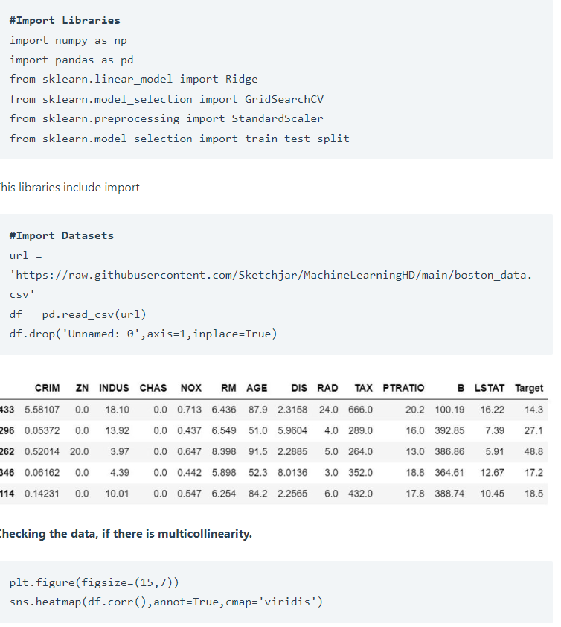
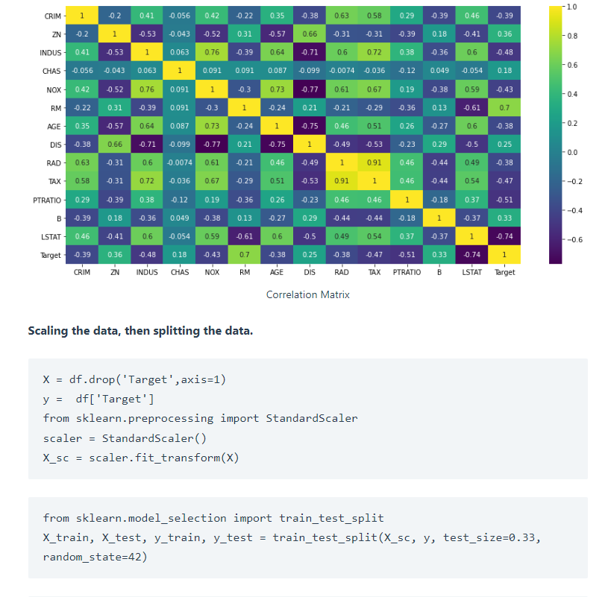

Slide 5
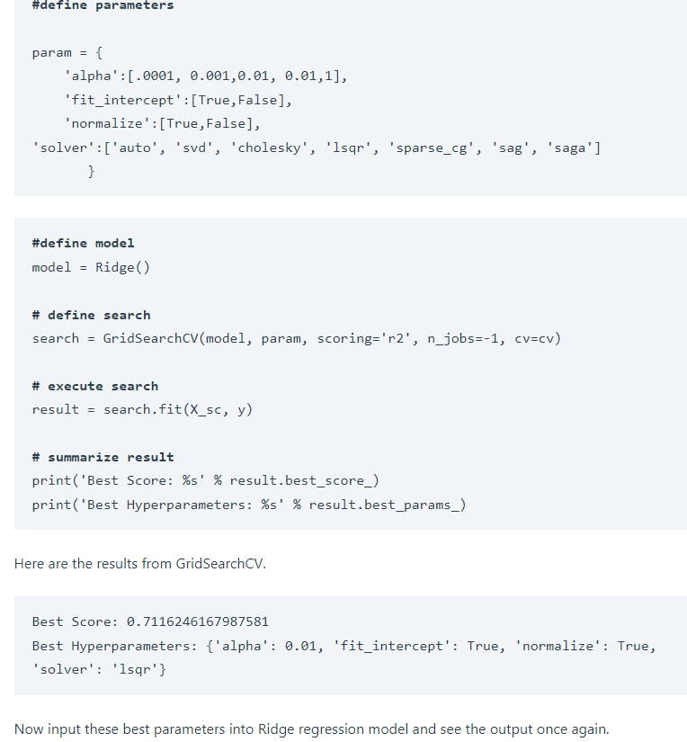
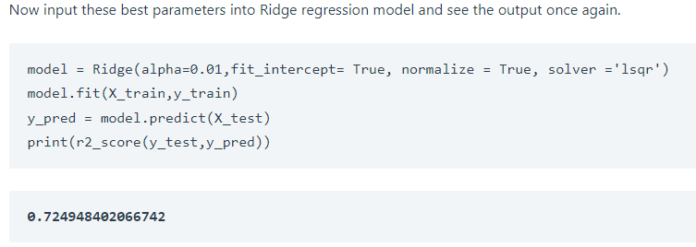
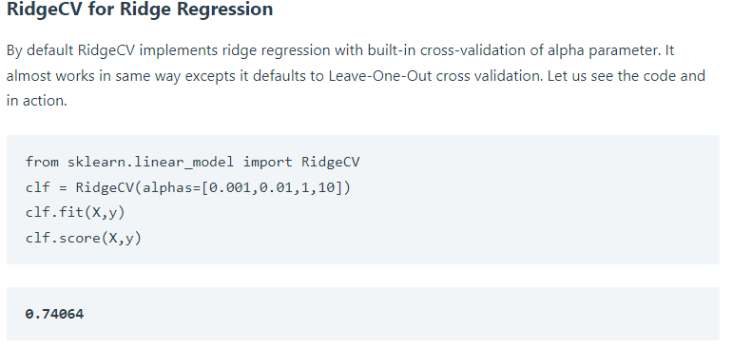

Slide 6
Reference
https://machinelearninghd.com/ridgecv-regression-python/

Slide 7
THANK YOU

